Slide 1
MapReduce

Slide 2
Why MapReduce?

Slide 3
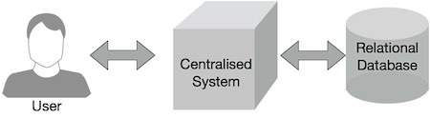
Traditional Enterprise Systems normally have a centralized server to store and process data. The following illustration depicts a schematic view of a traditional enterprise system. Traditional model is certainly not suitable to process huge volumes of scalable data and cannot be accommodated by standard database servers. Moreover, the centralized system creates too much of a bottleneck while processing multiple files simultaneously.

Slide 4
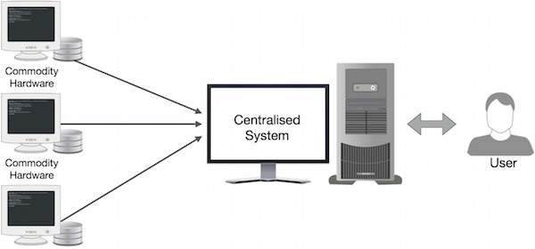
Google solved this bottleneck issue using an algorithm called MapReduce. MapReduce divides a task into small parts and assigns them to many computers. Later, the results are collected at one place and integrated to form the result dataset.

Slide 5
How MapReduce Works?
The MapReduce algorithm contains two important tasks, namely Map and Reduce.
The Map task takes a set of data and converts it into another set of data, where individual elements are broken down into tuples (key-value pairs).
The Reduce task takes the output from the Map as an input and combines those data tuples (key-value pairs) into a smaller set of tuples.
The reduce task is always performed after the map job.

Slide 6
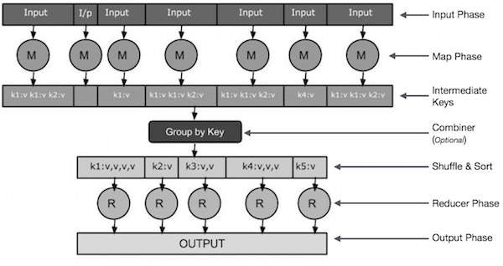

Slide 7
